Slide 1
Task #5: Exploratory Data Analysis
Business analytics approach
-Aditya Kaushik

Slide 2
Recommendations and Key Insights
States
Superstore per State
Profit per store (state-wise)
Effect of Discount on No. of sales
Category
Sub-categories
Profit per sale (Sub-category)
Segment and Shipping mode
Profit per sales (Segment and Shipping mode)

Slide 3
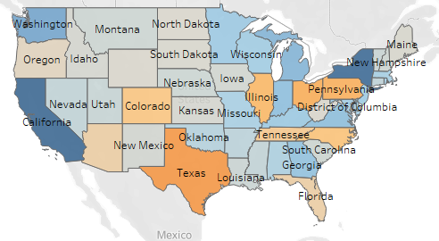

States
Highest Profitable states are California(76,381), New York(74,039) and Washington(33403).
There’s huge loss in Texas(-25,729), Ohio(-16,971) and Pennsylvania’s stores.
Superstores face loss in 10 States.

Slide 4
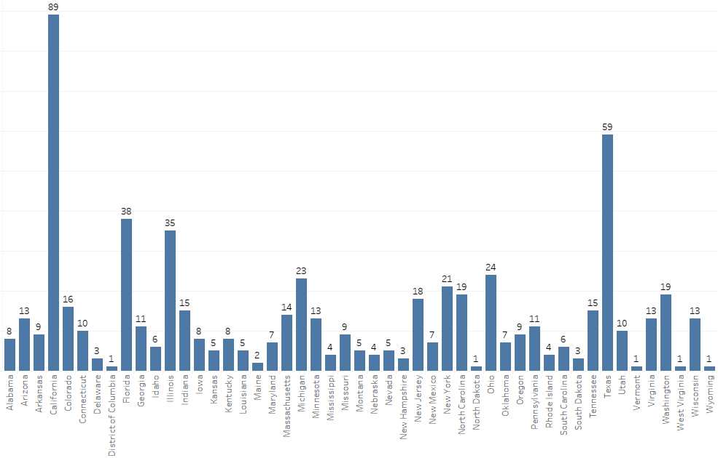
Superstore per State
New York and Washington gave huge profit irrespective of less no.s of stores. So company should work in order to increase the no. of stores in these states.
There are 59 and 11 stores in Texas and Pennsylvania respectively, so we can shift some stores to New York and Washington.

Slide 5
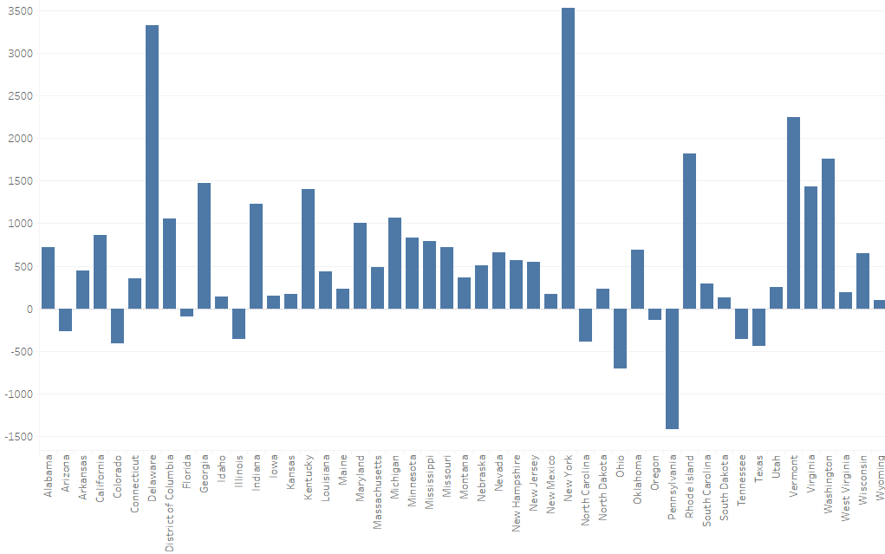
Profit per store (state-wise)
New York has the highest profit per store. Here we should focus on the customer retention.
There’s only 3 stores in Delaware but it has highest profit per store, so we can conclude that there’s a good market and company should think to start new stores here.
Pennsylvania’s superstores loss is the highest.

Slide 6
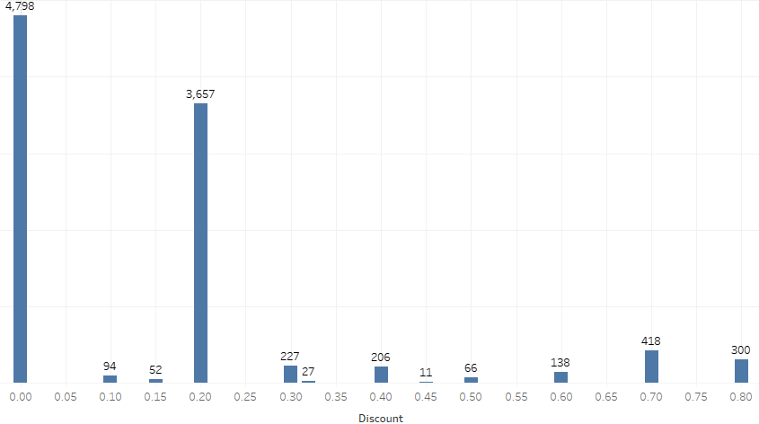
Effect of Discount on No. of sales
Sales are more in case of 20% discount and no discount.
We can see that high discount doesn’t gave the guarantee of more no. of sales.
Discount should not be very high, somewhere between 20-30 is the best.

Slide 7
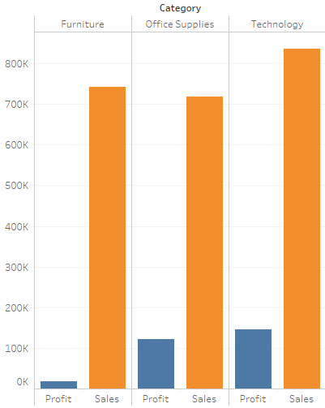
Category
Sales are almost same for all categories.
In case of Furniture, the profit is quite less than Office Supplies and Technology.
Company should try to focus more on Technology and Office supplies because they have give more profit.

Slide 8
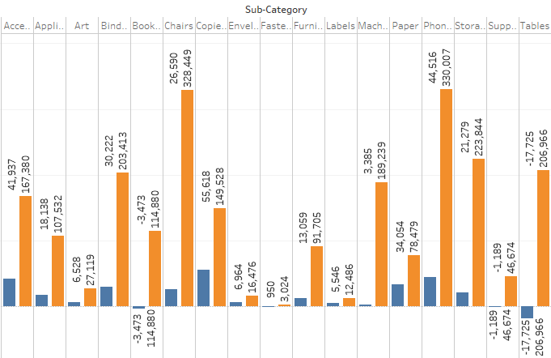

Sub-Categories
Sales of chairs and phones are more than the other sub-categories.
Sales of Table is also good, but profit is negative. So we should increase it’s price to get profit because the market of table is already big.

Slide 9
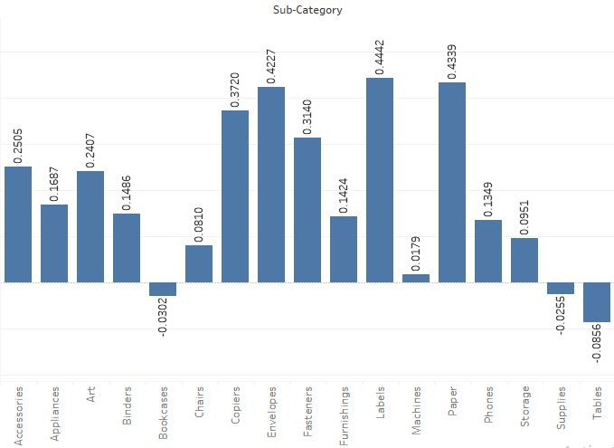
Profit per sale (Sub-category)
Profit per sale is more in Envelopes, Labels and Paper.
It is quite less in Tables, so we should increase it’s price to get profit.

Slide 10
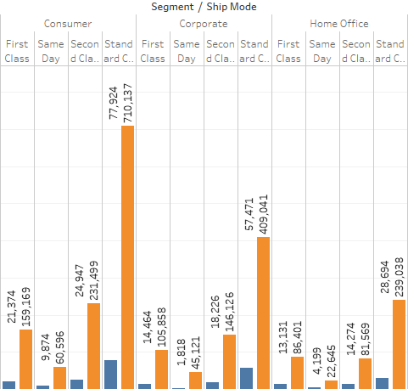
Segment and Shipping mode
Sales are more in Standard class in comparison to other shipping mode.
Maximum sales are in consumer’s Standard class.
So we can conclude that major percentage of consumers prefer standard class irrespective of their segment.

Slide 11
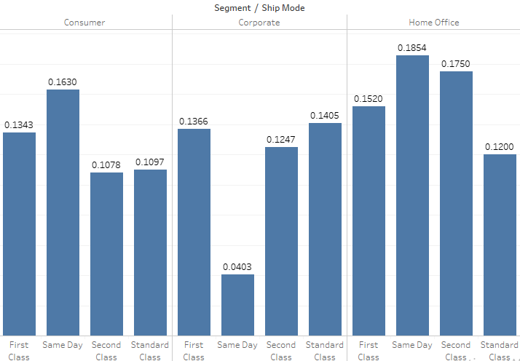
Profit per sales (Segment and Shipping mode)
We should focus more on home office segment, because irrespective of less no. of sales they have highest profit per sales ratio. So returns are more in case of Home office segment.

Slide 12
Thank You

